Slide 1
Unplanned Limb Revascularization with Rivaroxaban versus Placebo in Patients with Critical Limb Ischemia after Endovascular and Surgical Treatment: Insights from VOYAGER PAD
AHA Oral Abstract
November 7, 2022
Shea E. Hogan MD, Manesh R. Patel, MD, Eike Sebastian Debus MD, PhD, Mark R. Nehler, MD, Sonia S. Anand, MD, Mario Canonico, MD, PhD, Connie N. Hess, MD, MHS, Kevin Rogers MD, Judith Hsia MD, Eva Muehlhofer, MD, Lloyd P. Haskell, MD, MBA, Scott D. Berkowitz, MD, Rupert M. Bauersachs, MD, Marc P. Bonaca MD MPH

Slide 2
Disclosures
VOYAGER PAD funded through a grant from Bayer to CPC Clinical Research
CPC, a non-profit academic research organization affiliated with the University of Colorado, that receives research grant/consulting funding from: Abbott, Agios, Alexion Pharma, Alnylam, American Heart Association, Amgen, Angionetics, Anthos Therapeutics, ARCA Biopharma, Array, AstraZeneca, Atentiv, Audentes, Bayer, Better Therapeutics, Brigham and Women’s Hospital, Bristol-Myers Squibb, Cambrian Biopharma, Cardiol Therapeutics, CellResearch, Cook Regentec, CSL Behring, Eidos Therapeutics, EP Trading Co, EPG Communications, Epizon Pharma, Esperion Therapeutics, EverlyWell, Exicon Consulting, Faraday, Fortress Biotech, Heartflow, Insmed, Janssen, Kowa Research, Lexicon, Medtronic, Merck, Moderna, NIH, Novartis, NovoNordisk, Pfizer, PhaseBio, PPD Development, Prothena Biosciences, Regeneron, Regio Biosciences, St. Luke’s Hospital of Kansas City, Sanifit Therapeutics, Sanofi, Silence Therapeutics, Stealth BioTherapeutics, Thrombosis Research Institute, University of Colorado, University of Pittsburgh, VarmX, Worldwide Clinical Trials, Wraser, Yale Cardiovascular Research Group.
An affiliate of:

Slide 3
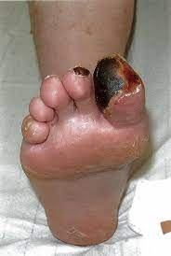
MACE or MALE in PAD with vs. without CLTI on ASA, >80% on statins in VOYAGER PAD Acute limb ischemia, major amputation for vascular cause, myocardial infarction, ischemic stroke, CV death
Critical Limb Ischemia
Over 230 million individuals worldwide are estimated to have PAD (>10% of individuals >40 years old) and >10% of those having Critical Limb Threatening Ischemia (CLTI).
CLTI represents the most severe manifestation of late-stage peripheral artery disease.
Outcomes after CLTI are poor with high risk of ischemic complications and amputation with subsequent mortality rates estimated as high as ~48%
Revascularization is recommended
(Class I) to prevent/minimize tissue loss
26.9%
CLI
N=1533
+10.2%
16.7%
10.7%
Cumulative Incidence (KM%)
Claudication
N=5031
+5.8%
4.9%
Tsao et al. Circulation 2022
Mills et al. JVS 2014; Gerhard-Herman et al. Circulation 2017
Days from Randomization
Bonaca et al. NEJM 2020

Slide 4
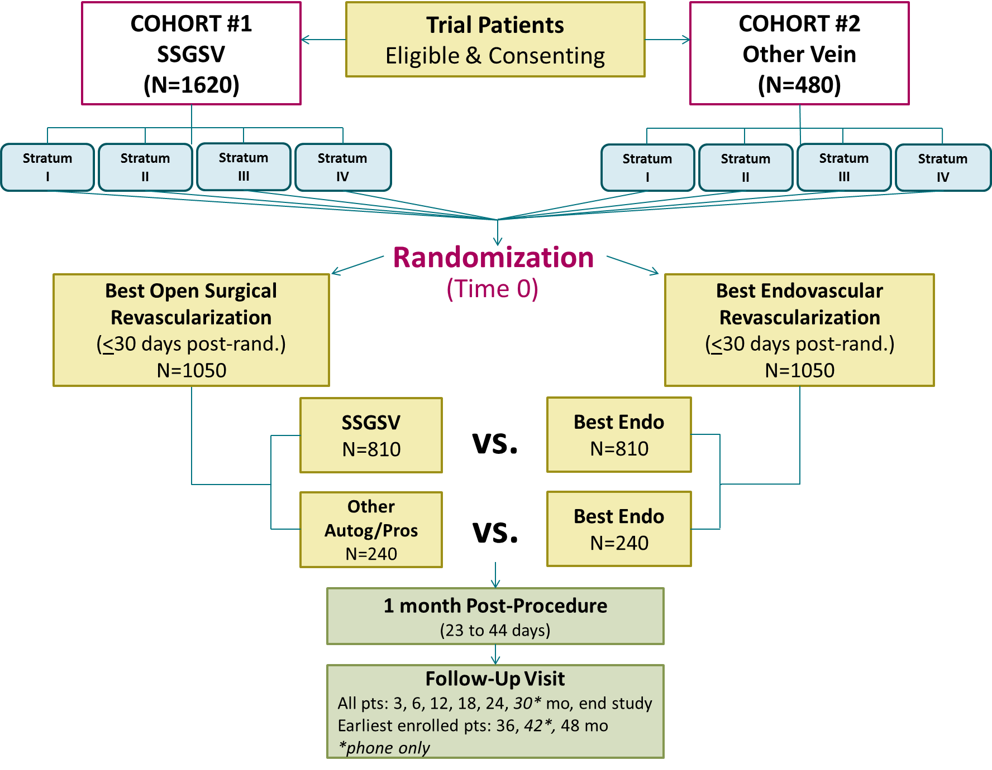
Stratification and Randomization
Best Endovascular vs.
Best Surgical Therapy
In Patients with
Critical Limb Ischemia
(BEST-CLI)

Slide 5
VOYAGER PAD Trial Design
*PAD defined as:
- Ischemic symptoms (functional limitation, rest pain or ischemic ulceration) AND
- Imaging evidence of occlusion AND
- Abnormal ABI/TBI
NCT02504216
6,564 Patients with Symptomatic Lower Extremity PAD* Undergoing Peripheral Revascularization
ASA 100 daily for all Patients
Clopidogrel at Investigator’s Discretion
Randomized 1:1 Double Blind
Rivaroxaban 2.5 mg twice daily
Placebo
Stratified by Revascularization Approach (Surgical or Endovascular with and without clopidogrel)
Follow up Q6 Months, Event Driven, Median f/u 28 Months
Primary Efficacy Endpoint: Acute limb ischemia, major amputation of vascular etiology, myocardial infarction, ischemic stroke or cardiovascular death
Principal Safety Outcome: TIMI Major Bleeding
Capell WH, Bonaca MP, Nehler MR…Hiatt WR. AHJ 2018
Bonaca MP…Hiatt WR NEJM 2020

Slide 6
Unplanned Index Limb Revascularization
HR 0.88 (0.79 – 0.99)
P=0.028
ARR 2.5%, NNT 40
6,564 Patients with Symptomatic Lower Extremity PAD* (CLI or Claudication) Undergoing Peripheral Revascularization
*PAD defined as:
- Ischemic symptoms (functional limitation, rest pain or ischemic ulceration) AND
- Imaging evidence of occlusion AND
- Abnormal ABI/TBI
Km(%) at 3 years
All to receive standard of care including:
Low dose aspirin
Clopidogrel per investigator

Slide 7
Baseline Characteristics
Characteristics at Randomization, CLI Patients | Endo N=837 % | Surgery N=696 %
Age, Yrs Median | 69 | 66
Female | 35 | 21
Caucasian | 70 | 90
Diabetes Mellitus | 58 | 34
COPD | 8 | 12
eGFR < 60 ml/min/1.73m² | 30 | 16
Coronary Artery Disease | 27 | 32
Prior MI | 8 | 8
Known Carotid Stenosis | 7 | 7
Statin | 81 | 82
ACEi or ARB | 62 | 57
Characteristics at Randomization, CLI Patients | Endo N=837 % | Surgery N=696 %
Peripheral Artery Disease History
History of Claudication | 77 | 89
History of Revascularization | 30 | 23
History of Amputation | 19 | 11
Ankle Brachial Index, Median (IQR) | 0.5 (0.36 – 0.62) | 0.4 (0.27 – 0.5)
Type of Revascularization
Days from Procedure to Rando, Median (IQR) | 2 (1 – 6) | 4 (2 – 6)
Target Lesion Length
Short (< 5cm) | 21 | 12
Intermediate (5cm to < 15cm) | 42 | 34
Long (≥ 15cm) | 37 | 54
CLI = Rutherford 4-6, No CLI = Rutherford 2-3/Claudication

Slide 8
Net Clinical Benefit Acute limb ischemia, major amputation of a vascular etiology, myocardial infarction, ischemic stroke, all cause mortality, ICH or fatal bleeding
Placebo
Rivaroxaban
With CLI
N=1,521*
P-interaction 0.77
Without CLI
N=4,983*
3 Year
ARR 5.7%
HR 0.78
95% CI 0.61 – 1.00
p=0.0457
HR 0.74
95% CI 0.63 – 0.88
p=0.0003
24.9%
3 Year
ARR 3.9%
17.5%
19.2%
NNT 18
Cumulative Incidence (KM%)
Cumulative Incidence (KM%)
13.6%
NNT 26
Days from Randomization
*Safety Population, On-Treatment Scope

Slide 9
Unplanned Index Limb Revascularization
With CLI
N=1533
Unplanned lower extremity revascularization that occurred after index procedure, not including planned staged procedure
Ischemia*
Ultrasound findings (e.g., stent restenosis)
Bleeding
Graft infection
Prespecified secondary outcome, positive in overall trial, positive in CLI subgroup
HR 0.78
95% CI 0.62 – 0.99
P=0.0376
23.4%
Placebo
Rivaroxaban
17.5%
3 Year
ARR 5.9%
NNT 17
Cumulative Incidence (KM%)
Days from Randomization
ARR – absolute risk reduction, NNT number needed to treat

Slide 10
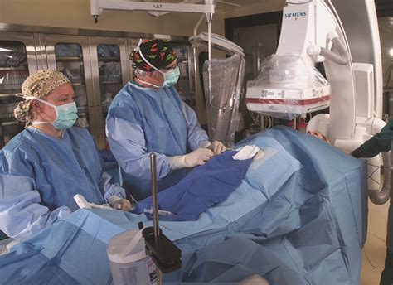
Hypothesis
Total of 1533 with CLI
The benefit of a rivaroxaban 2.5 mg twice daily strategy with aspirin compared to aspirin alone will be consistent regardless of endovascular or surgical approach for CLTI
Surgical
Endovascular

Slide 11
Methods
Patients assigned Rutherford 4-6 (CLI) classification at the time of qualifying revascularization by trained vascular investigators.
Efficacy
Primary composite (ITT) of acute limb ischemia, major amputation of a vascular etiology, myocardial infarction, ischemic stroke or CV death
Pre-specified secondary outcome of unplanned index limb revascularization, stratified by revascularization approach (surgical versus endovascular) significantly reduced in overall trial with rivaroxaban
Safety
Principle safety outcome (on-treatment) of TIMI major bleeding
A Cox proportional-hazards model was used to calculate hazard ratios and 95% confidence intervals

Slide 12
Unplanned Index Revascularization with Rivaroxaban versus Placebo in Patients with CLI Treated with Endovascular versus Surgical Revascularization
All to be receiving aspirin
>80% on statins
randomized to placebo
n/N (%)
122
161
79
112
43
49
N=771
N=428
N=343

Slide 13
Unplanned Index Revascularization with Rivaroxaban versus Placebo in Patients with CLI Treated with Endovascular versus Surgical Revascularization
P-interaction = 0.70
HR 0.75
(0.56 – 1.00)
HR 0.83
(0.55 – 1.25)
HR 0.78
(0.62 – 0.99)
P=0.019
n/N (%)
122
161
79
112
43
49
N=762
N=771
N=409
N=428
N=353
N=343

Slide 14
Unplanned Index Revascularization with Rivaroxaban versus Placebo in Patients with CLI Treated with Clopidogrel versus no Clopidogrel
All to be receiving aspirin, >80% on statins
n/N (%)
122
161
62
84
60
77
N=771
N=335
N=434

Slide 15
Unplanned Index Revascularization with Rivaroxaban versus Placebo in Patients with CLI Treated with Clopidogrel versus no Clopidogrel
P-interaction = 0.97
HR 0.77
(0.55 – 1.07)
HR 0.78
(0.56 – 1.09)
HR 0.78
(0.62 – 0.99)
P=0.019
n/N (%)
122
161
62
84
60
77
N=762
N=771
N=326
N=335
N=436
N=434

Slide 16
TIMI major Bleeding with Rivaroxaban versus Placebo in Patients with CLI by Revascularization Type and Clopidogrel Use
HR 1.97
(0.77, 5.02)
HR 1.24
(0.67, 2.30)
P-interaction 0.53
HR 1.74
(0.90, 3.36)
P-interaction 0.18
HR 0.60
(0.14, 2.49)
n/N (%)
3
5
12
7
6
6
9
6
N=409
N=428
N=353
N=343
N=326
N=335
N=436
N=434

Slide 17
Summary
In VOYAGER PAD, symptomatic PAD who underwent successful lower extremity revascularization for critical limb ischemia were at very high risk of heart, limb and brain events, with
~1 in 10 having a first event within 6 months of revascularization
> 1 in 4 having a first event within 3 years of revascularization
Rivaroxaban 2.5 mg twice daily with aspirin significantly reduces this risk, with early and continued benefit over time, and with consistency in those with and without CLI
This benefits includes a reduction in the need for unplanned index limb revascularization for recurrent ischemia in patients presenting with CLI
This benefit is consistent for CLI patients undergoing surgical and endovascular revascularization
Endovascular ARR 6.9% with NNT 15; surgical ARR 2.1% with NNT 48
A trend towards more bleeding was observed in the endovascular arm and appears related to DAPT, so efforts to reduce bleeding risk and shorten DAPT exposure should be considered

Slide 18
Conclusions
Low-dose rivaroxaban with low dose aspirin reduces MACE, MALE, and unplanned index limb revascularization in critical limb ischemia patients who have undergone lower extremity revascularization.
These benefits are consistent regardless of surgical or endovascular approach.
Bleeding risk may be attenuated by reducing DAPT exposure, which is not evidence based in this population.
BEST CLI demonstrated there is a great need for adjuvant medical therapy in this population after revascularization.
Rivaroxaban should be considered in all critical limb ischemia patients who undergo lower extremity revascularization, regardless of the procedural approach, as a medical adjuvant to decrease cardiovascular and limb events in this high-risk population.

